Slide 1
Apache Kafka

Slide 2
Introduction of Apache kafka.
What is need of Apache Kafka.
Architecture of Apache Kafka.
Components of Apache Kafka.
Real world use cases.

Slide 3
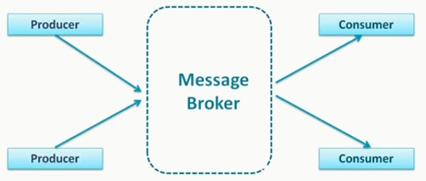
Apache Kafka Introduction
Apache Kafka is an open source software platform which is based on a distributed streaming process.
The official documentation says that Apache Kafka is similar to enterprise messaging system.

Slide 4
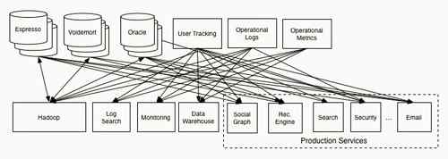
There may be a situation like

Slide 5
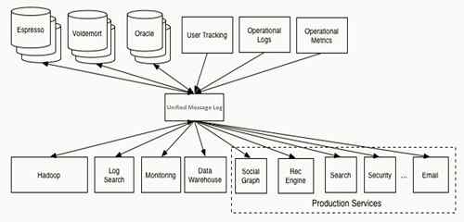

Slide 6
What is Apache Kafka
As we know Apache Kafka is a distributed streaming platform and Kafka is a highly scalable and fault tolerant enterprise messaging system.
Let’s Look at Apache Kafka Diagram in the official website.

Slide 7
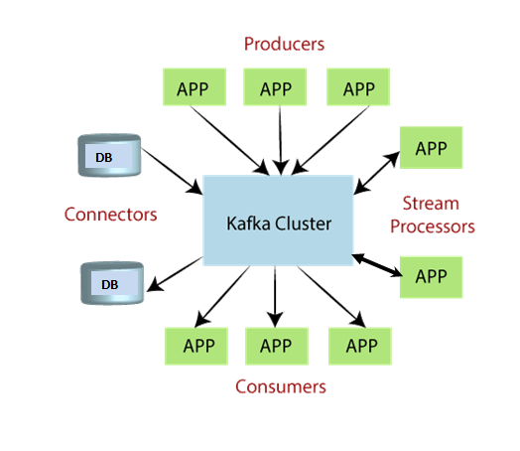

Slide 8
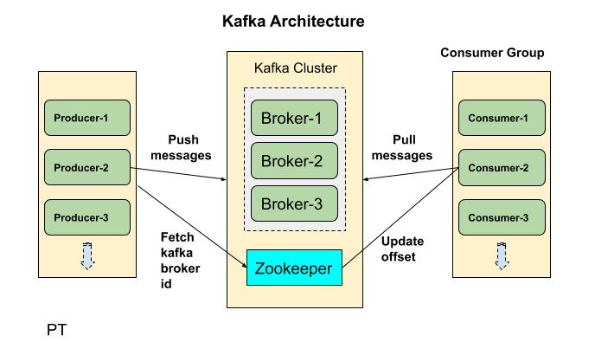

Slide 9
Components
Producers
Consumers
Broker
Topic
Partitions
Offset
Consumer Group

Slide 10
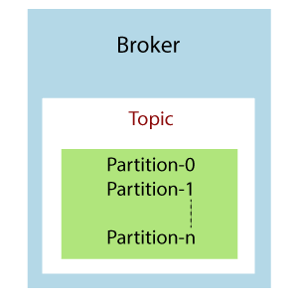

Slide 11
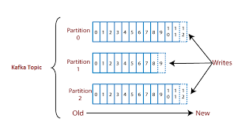

Slide 12
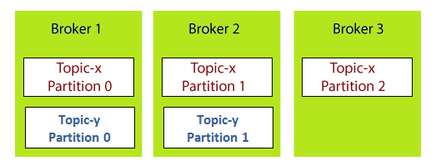

Slide 13
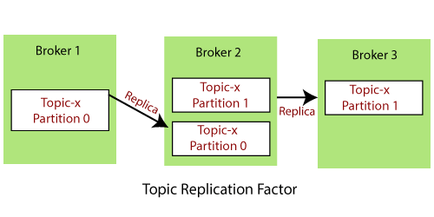

Slide 14
What is need of Apache Kafka
a. Scalability
Apache Kafka can handle scalability in all the four dimensions, i.e. event producers, event processors, event consumers, and event connectors. In other words, Kafka scales easily without downtime.
b. High-Volume
Kafka can work with a huge volume of data streams, easily.
c. Data Transformations
Kafka offers provisions for deriving new data streams using the data streams from producers.
d. Fault Tolerance
Kafka clusters can handle failures with the masters and databases.

Slide 15
e. Reliability
Since Kafka is distributed, partitioned, replicated, and fault tolerant, it is very reliable.
f. Durability
It is durable because Kafka uses Distributed commit logs, which means messages persist on disk as fast as possible.
g. Performance
For both publishing and subscribing messages, Kafka has high throughput. Even if many TBs of messages are stored, it maintains stable performance

Slide 16
h. Zero Downtime
Kafka is very fast and guarantees zero downtime and zero data loss.
i. Extensibility
There are many ways by which applications can plug in and make use of Kafka. In addition, Kafka offers ways to write new connectors as needed.
j. Replication
By using ingest pipelines, it can replicate events.

Slide 17
Use Cases of Apache Kafka
Data Streaming
Web Activities
Log Aggregations
Commit Log
Event Sourcing
Metrics :
Apache Kafka is used to monitor operational data by producing centralized feeds of that data. Operational data means monitoring things from technology to security logs to supplier information, and so on.

Slide 18
Real World Use Cases
Website activity tracking (Amazon)
Data Streaming (Uber)

